Slide 1
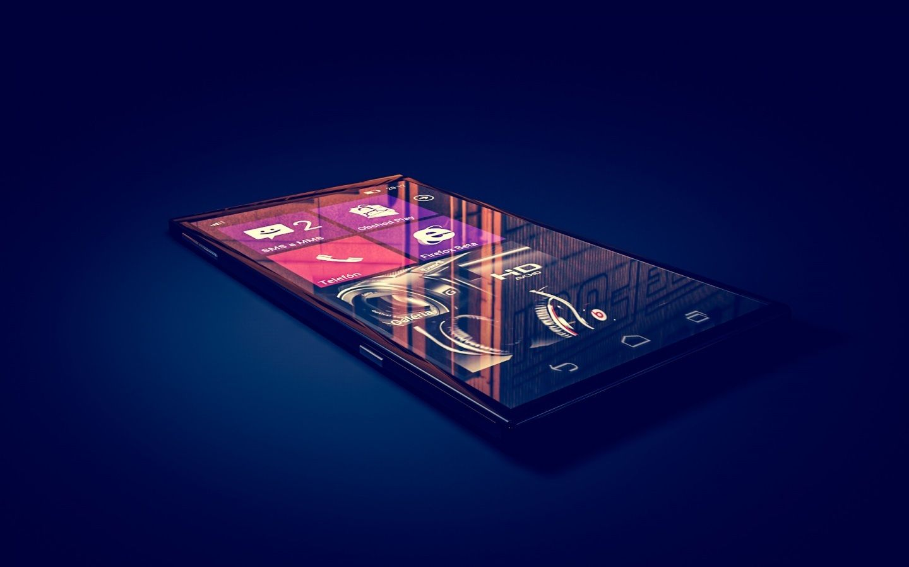

Mobile Phone Industry
Shion Wakita – BA630

Slide 2
Possible Products
Smart Watch
Tablet
Desktop
Smart Phone
Laptop
Flip Phone

Slide 3
Consumer Substitute: Performance
Desktop
Laptop
Tablet
Smart Phone
Smart Watch
Flip Phone

Slide 4
Consumer Substitute: Portability
Desktop
Laptop
Tablet
Flip Phone
Smart Phone
Smart Watch

Slide 5
Consumer Substitute: Use Case
Text & Call
Smart Phone
Word Process
Desktop
Design / Development
Desktop
Flip Phone
Smart Watch
Laptop
Tablet
Laptop
Tablet

Slide 6
Producer Substitute
Internal Components
Form Factor
Software

Slide 7
Our Industry Definition
Manufacturing mobile devices that have cellular connection, portability (either hand-held or worn), and the ability to perform the basic functions of both texting and calling

Slide 8
Other Industry Definition
NAICS
(Broader)
“..primarily engaged in manufacturing radio and television broadcast and wireless communications equipment”
Statista
(Closer)
“..features both mobile phones in classical sense (cell phones) and smartphones(featuring a personal computer, internet connection, etc.)”

Slide 9
Selected Products
Smart Watch
Tablet
Desktop
Smart Phone
Laptop
Flip Phone

Slide 10
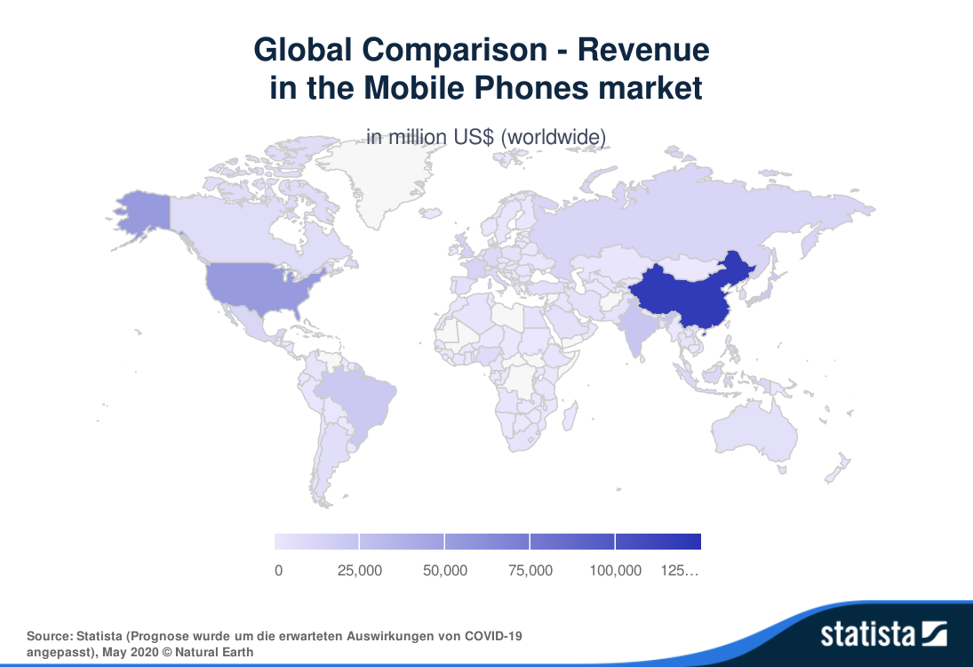
Geographic Scope
Conclusion
Global Market
Highly shippable

Slide 11





Value Chain
Design
Manufacturing
Components
Assembly
Software
Installation
Distribution

Slide 12
Products in Five Forces
Competitive Rivalries
Threat of New Entry: -Amazon
Supplier Power: -Google/Apple -Qualcomm -Samsung -Foxconn
Threat of Substitution: -Tablet -Laptop -Used Phone
Buyer Power: -Retailers -Network Operators -Individuals -Business
Competitive Rivalries:
Apple
Samsung
Huawei
Sony

Slide 13
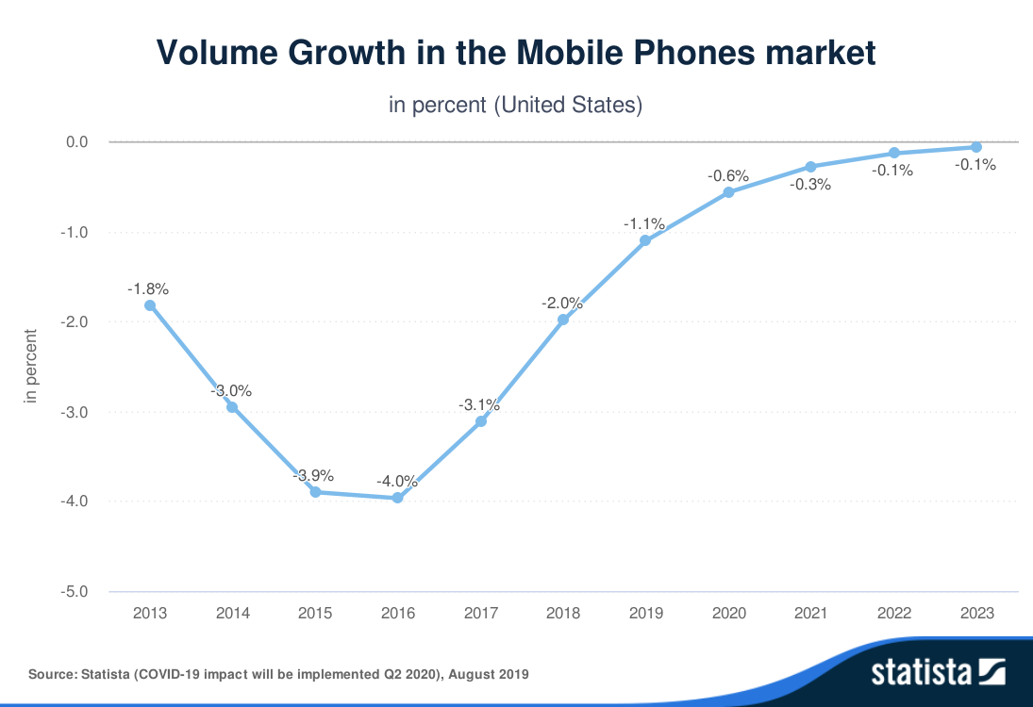
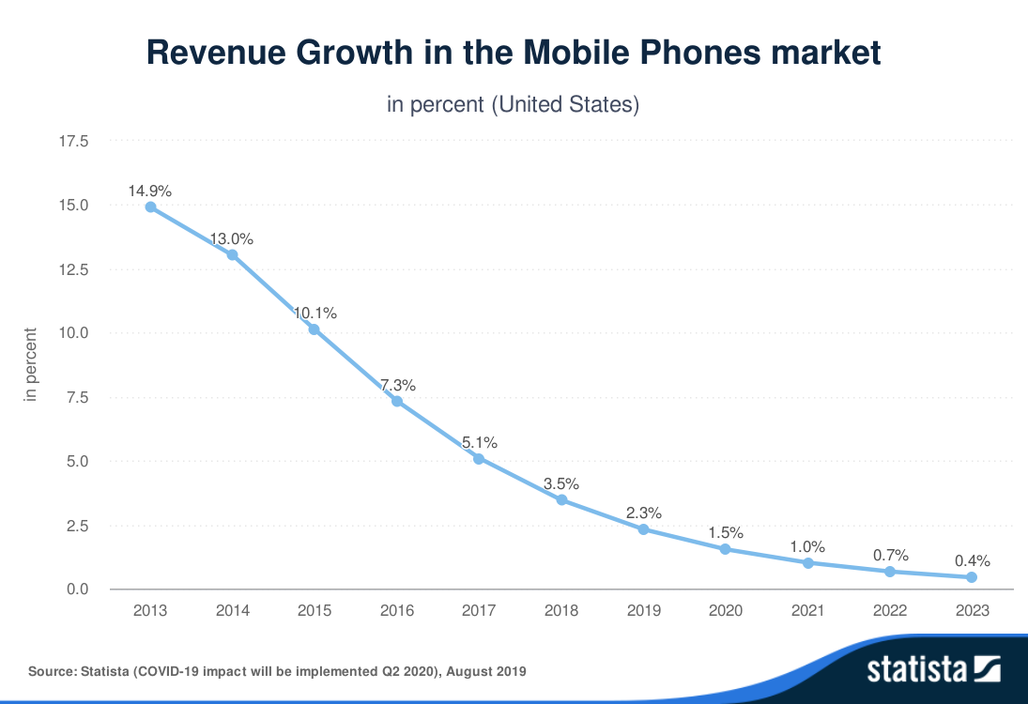
Rivalry: Industry Growth Rate (US)
Conclusion:
Low growth
High rivalry

Slide 14
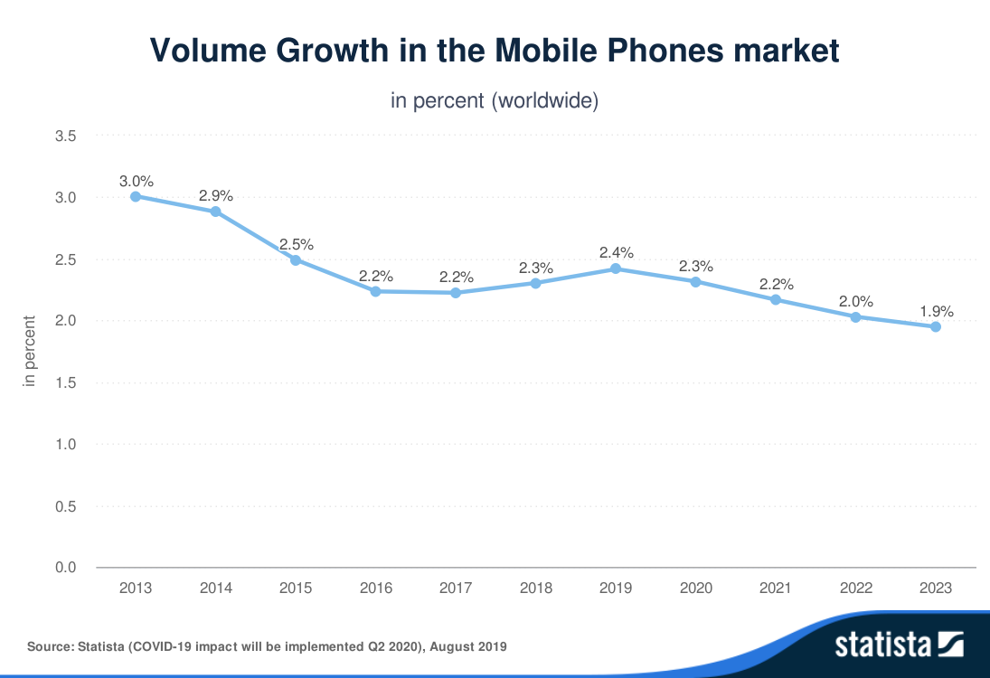
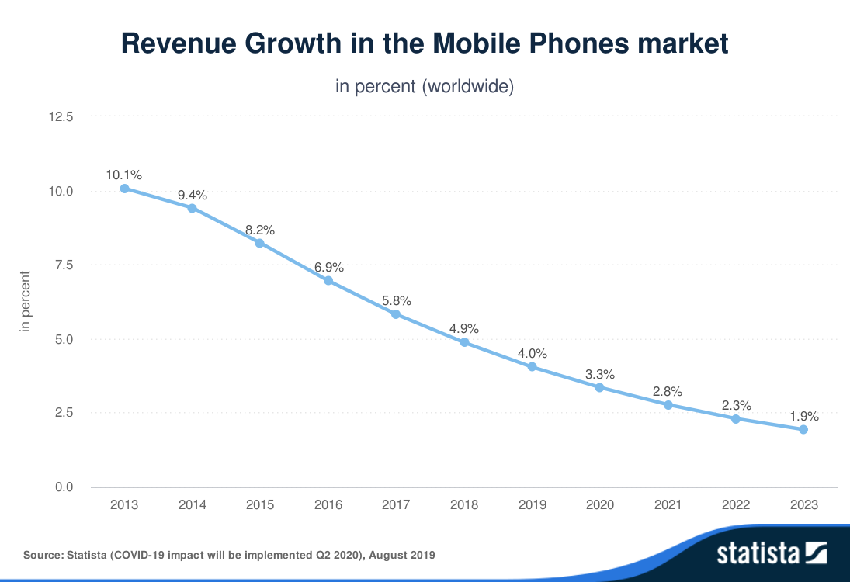
Rivalry: Industry Growth Rate (World)
Conclusion:
Low growth
High rivalry

Slide 15
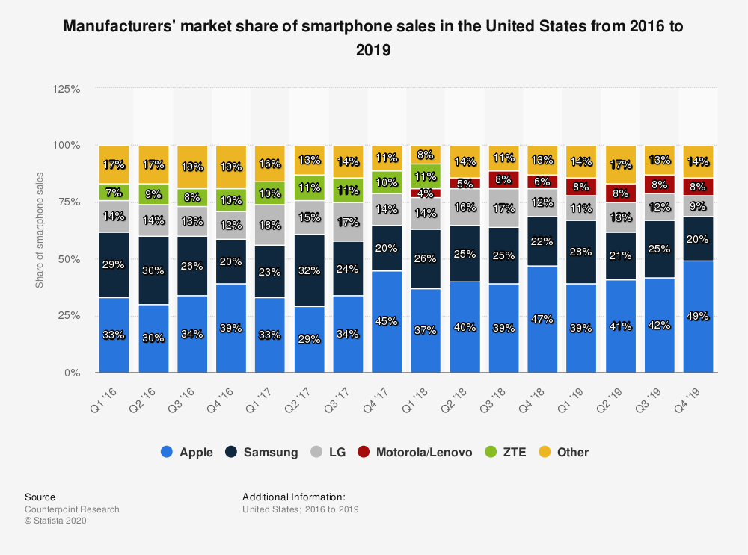
Rivalry: Concentration Ratio (US)
Concentration Ratio
86%
Conclusion
High Concentration Ratio
Low Rivalry

Slide 16
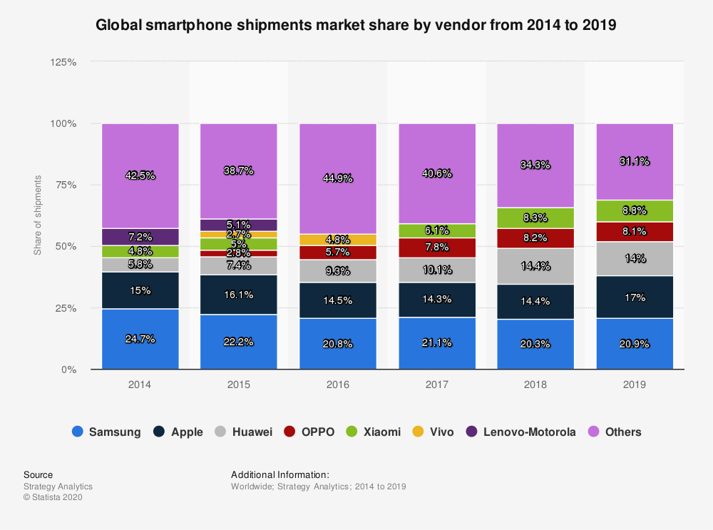
Rivalry: Concentration Ratio (World)
Concentration Ratio
60%
Conclusion
Medium - High Concentration Ratio
Medium Rivalry

Slide 17
Rivalry: Marginal / Fixed Cost
* Apple Inc. reported $91.8 billion in net sales
Cost Type | Expenses | *Percentage of Total Net Sales
Fixed Cost | R&D | 5%
 | Selling & GA | 6%
Conclusion
Moderate Fixed Cost
High rivalry (Samsung/Apple)

Slide 18
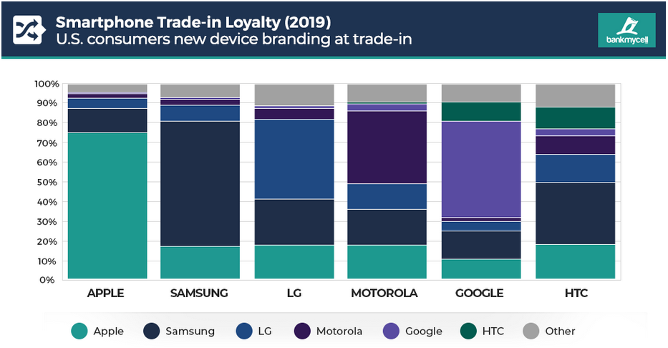
Rivalry: Brand Loyalty
Conclusion
Moderate ~ high brand loyalty
Low rivalry

Slide 19
Rivalry: Product Differentiation (US)
Company | Customer Satisfaction Score (ACSI)
Apple | 81
Samsung | 81
Motorola (Lenovo) | 80
Cellular Telephones | 79
LG | 78
All Others | 72
Conclusion
High ACSI Score
High Rivalry

Slide 20
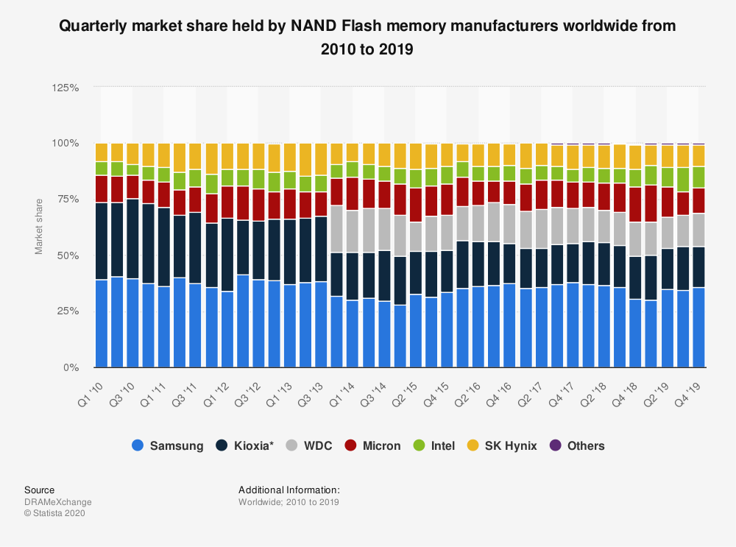
Supplier: Concentration (NAND)
Industry CR
60%
Concentration Ratio
~80%
Conclusion
Suppliers have high power

Slide 21
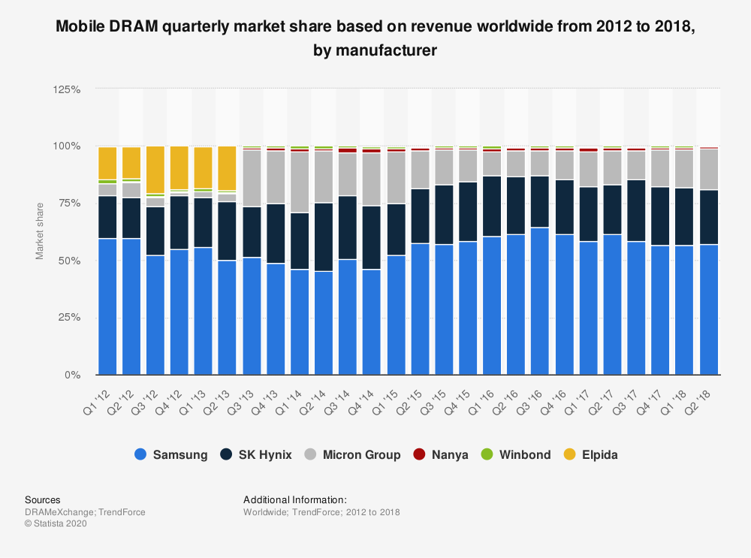
Supplier: Concentration (DRAM)
Industry CR
60%
Concentration Ratio
~99%
Conclusion
Suppliers have very high power

Slide 22
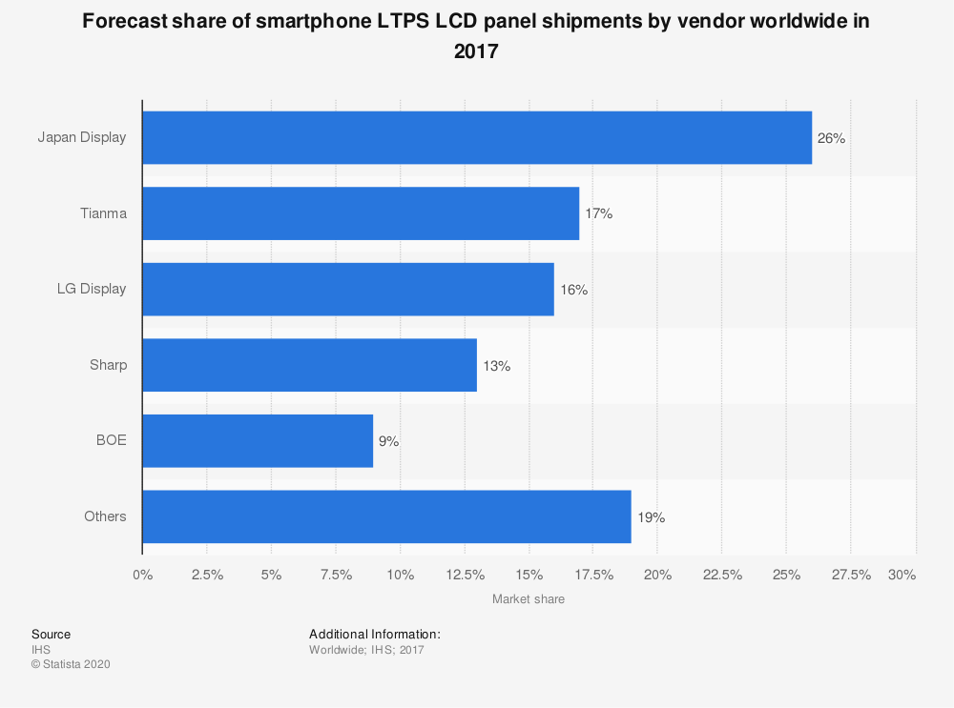
Supplier: Concentration (LCD)
Industry CR
60%
Concentration Ratio
72%
Conclusion
Suppliers have high power

Slide 23
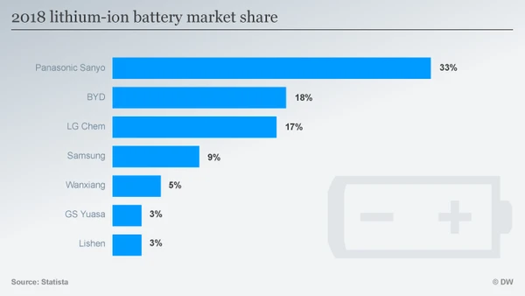
Supplier: Concentration (Battery)
Industry CR
60%
Concentration Ratio
77%
Conclusion
Suppliers have high power

Slide 24
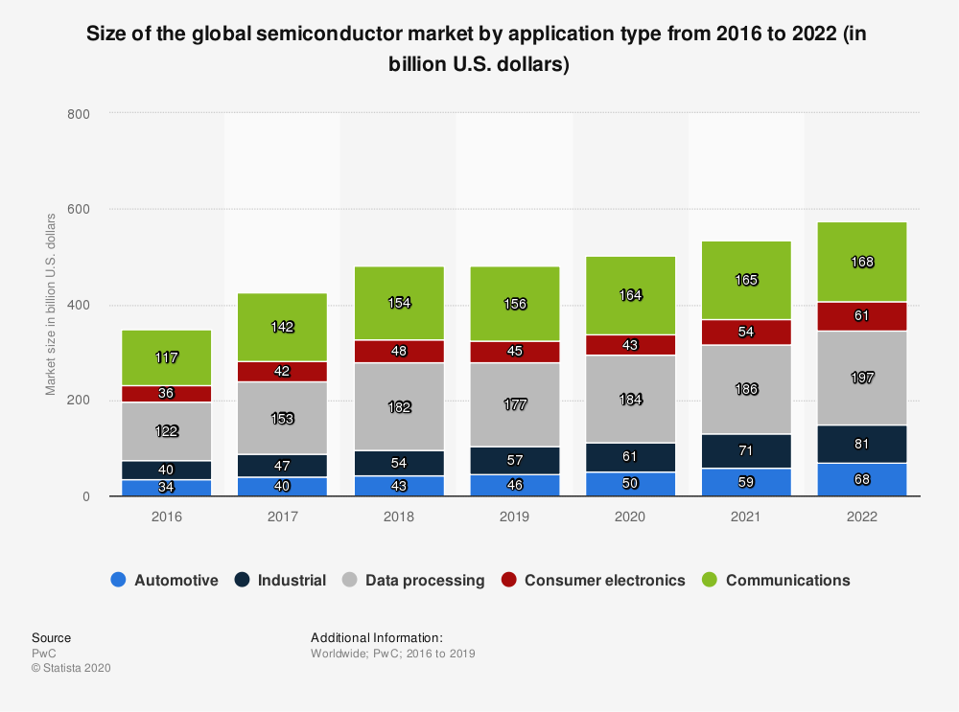
Supplier: Dependency on Industry (Overall)
9.3%
Conclusion
Suppliers have high power

Slide 25
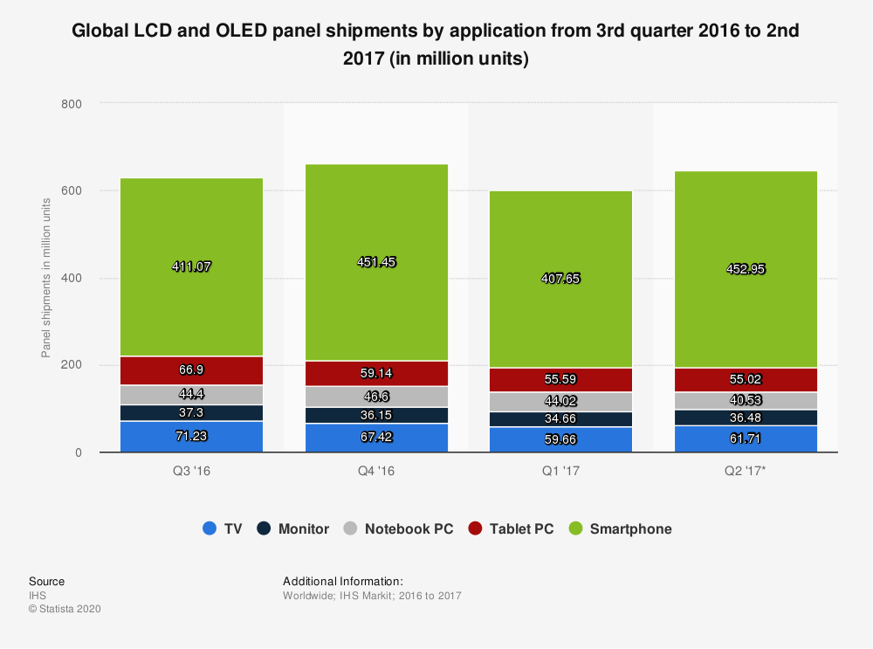
Supplier: Dependency on Industry (Display)
70%
Conclusion
Suppliers have low power

Slide 26
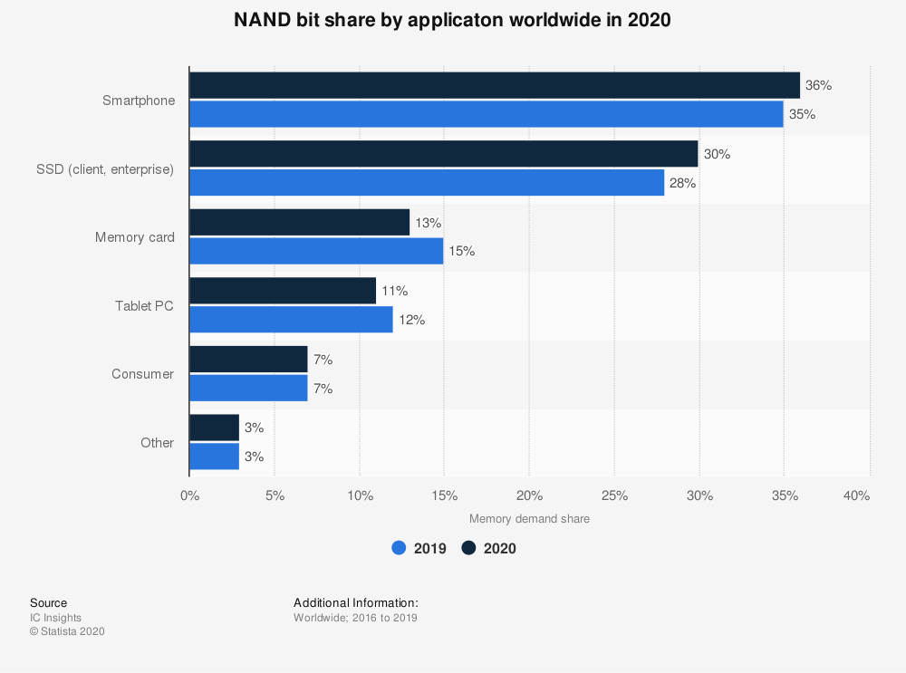
Supplier: Dependency on Industry (NAND)
35%
Conclusion
Suppliers have high power

Slide 27



Supplier: Forward Integration
Semiconductor companies can forward integrate to manufacturing process, but better off sticking to current / original methods.

Slide 28
Supplier: Switching Cost
Low switching cost components
Cameras
Screens
Sensors
Storage / Memory
High switching cost components
Processors
Conclusion
Only processor companies have power

Slide 29
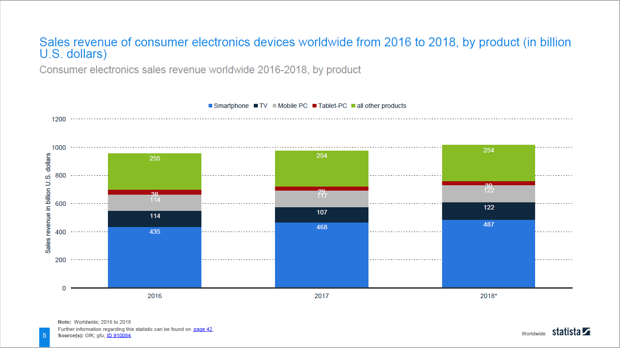
Buyer: % of Total Revenue for Retailers (World)
47.9%
Conclusion
Largest portion of revenue
High dependence on industry
Low power to negotiate

Slide 30
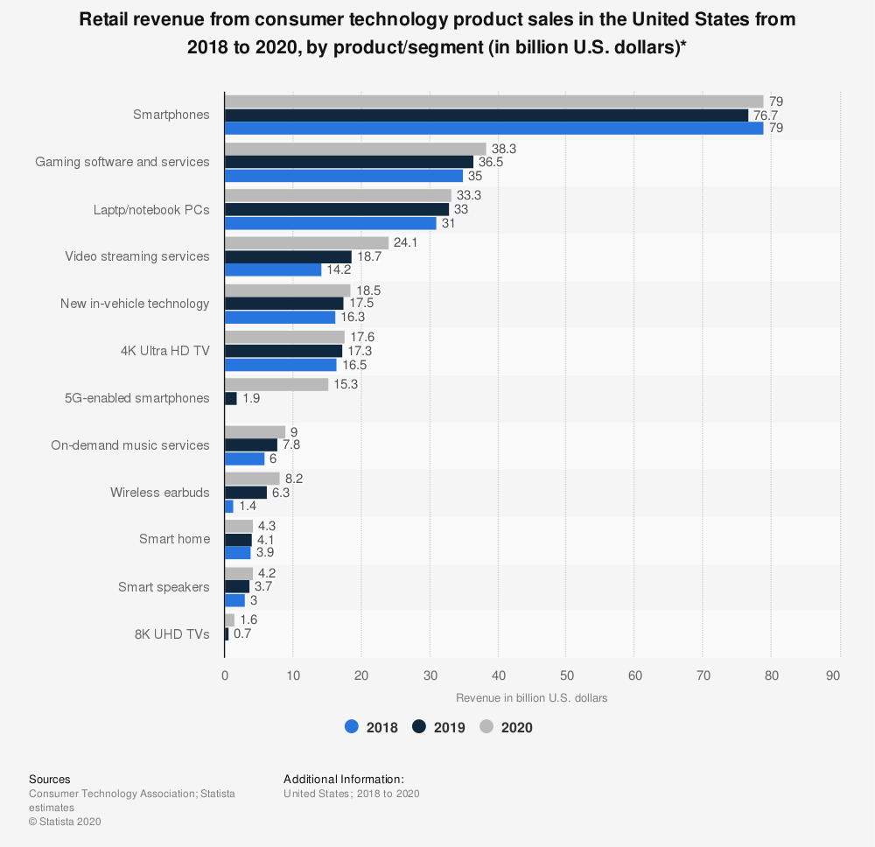
Buyer: % of Total Revenue for Retailer (US)
34.6%
Conclusion
Largest portion of revenue
Buyers have low power
Higher power to negotiate

Slide 31
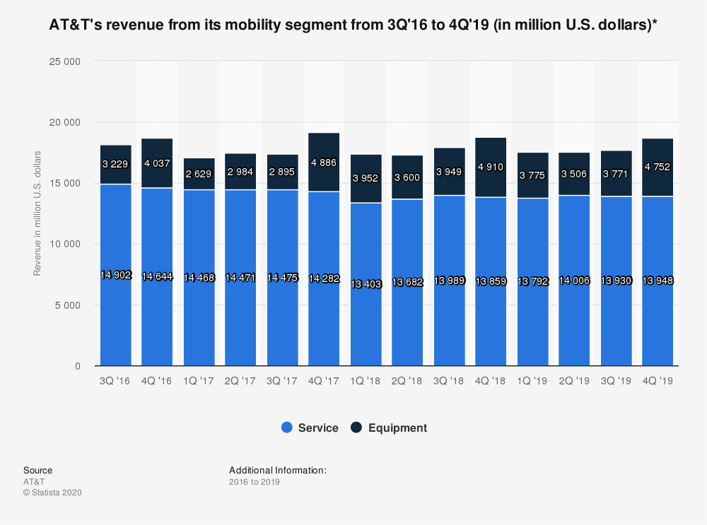
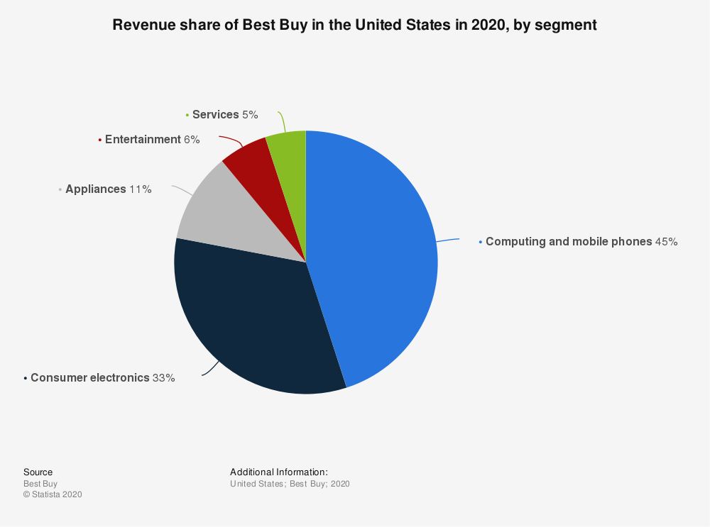
Buyer: % of Revenue (Best Buy)
45%
Conclusion
Largest revenue source
Buyers have medium power

Slide 32
Buyer: % of Revenue (AT&T)
25.4%
Conclusion
Buyers have high power

Slide 33
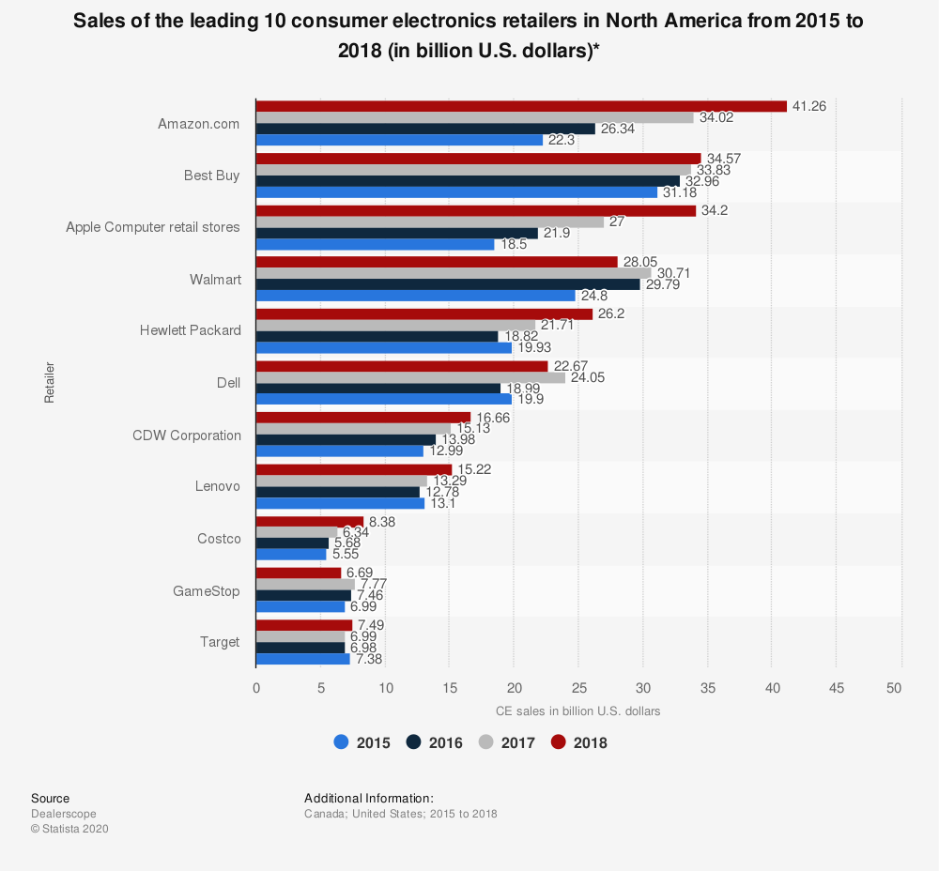
Buyer: Concentration (Retailer)
Industry CR
86%
Concentration Ratio
42.8%
Conclusion
Buyers have low power

Slide 34
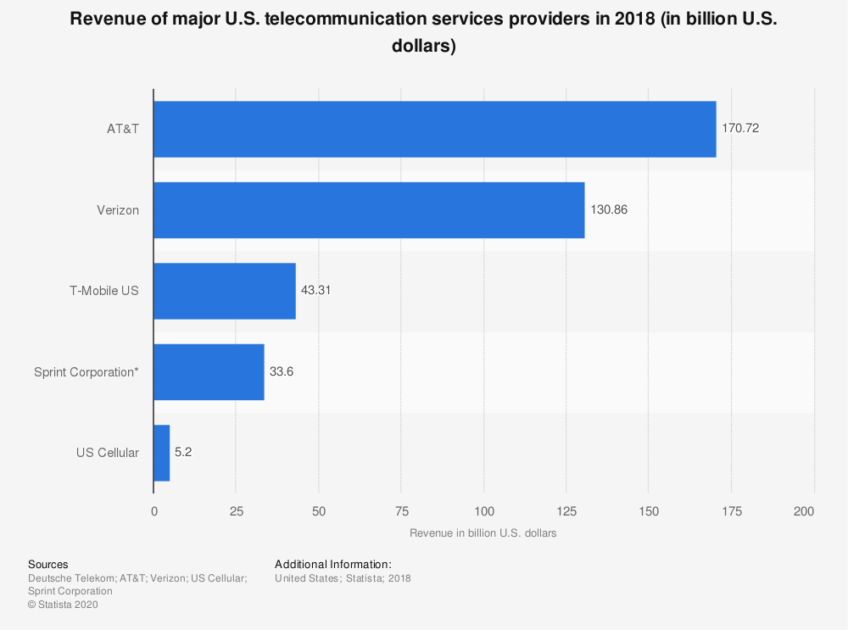
Buyer: Concentration (Wireless Provider)
Industry CR
86%
Concentration Ratio
90~%
Conclusion
Highly concentrated
Buyers have moderate power

Slide 35

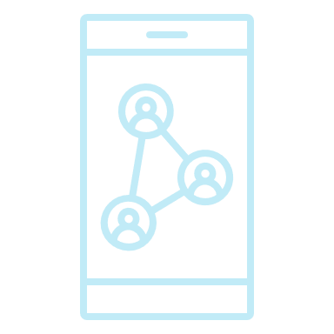
Buyers: Switching Cost
Switching cost from Android to Android is low, no switching cost within iOS devices
Switching cost may be high if the consumer is adapted to a certain operating system / ecosystem and switching to the other.
Conclusion
Medium / high switching cost

Slide 36

Buyers: Backward Integration
Larger retailers (such as BestBuy) has the ability to backward integrate and contract out manufacturing and assembly.

Slide 37
Substitute: Price Comparison
Product Name | Product Price
iPhone / Galaxy / Pixel | $100~$1000
iPad / Surface / Galaxy / Nexus | $300~$900
Windows Laptop (HP / Lenovo / HP / Dell / Pixel book) | $600~$2000

Slide 38
Substitute: Use Cases
Product Name | Use Cases
iPhone / Galaxy / Pixel | Texting / Calling
iPad / Surface / Galaxy / Nexus | Word Processing / Photo & Video Playback
Windows Laptop (HP / Lenovo / HP / Dell / Pixel book) | Word Processing / Light~Moderate Development & Editing
Conclusion
Different use cases
Low threat of substitution

Slide 39
Substitute: Performance Comparison
Product Name | Category | Performance
iPhone / Galaxy / Pixel | Phone | Low to Moderate
iPad / Surface / Galaxy / Nexus | Tablet | Moderate
Windows Laptop (HP / Lenovo / HP / Dell / Pixel book) | Laptop | Moderate to High
Conclusion
Different use cases
Low threat of substitution

Slide 40

Substitute: Conclusion
Users are unlikely to substitute one device category for the other
Different category device serves different purpose
Users will most likely have devices from multiple categories
Conclusion
Low threat of substitution

Slide 41
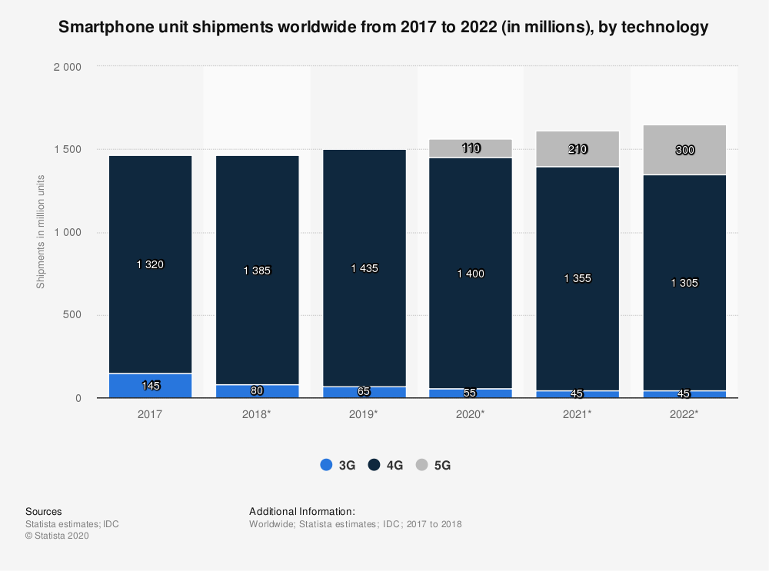
Complements: Cellular Network
Conclusion
Symbiotic relationship
New networks increase smartphone sales

Slide 42
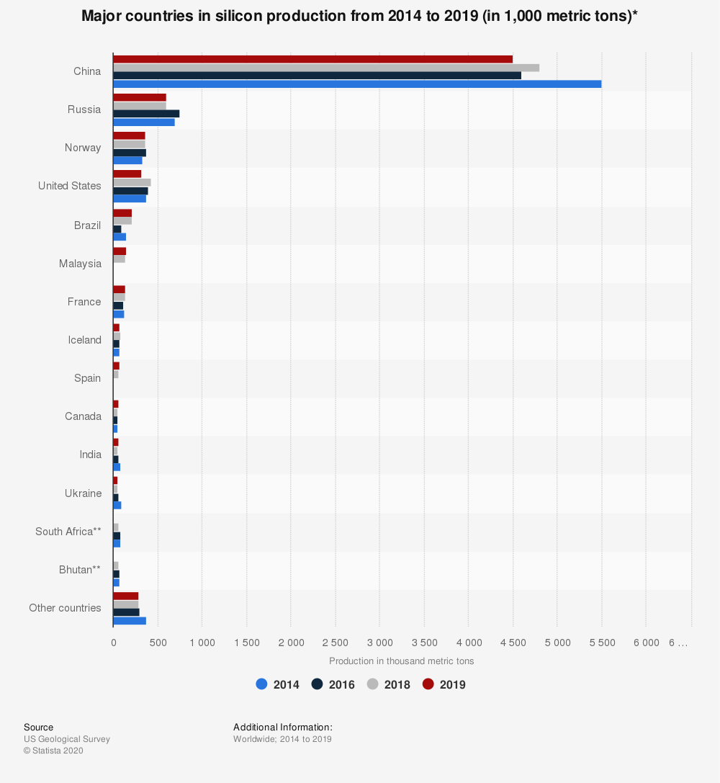
Entrants: Access to Raw Materials
Conclusion
Easier entry for companies in China or companies that contract out to Chinese company

Slide 43
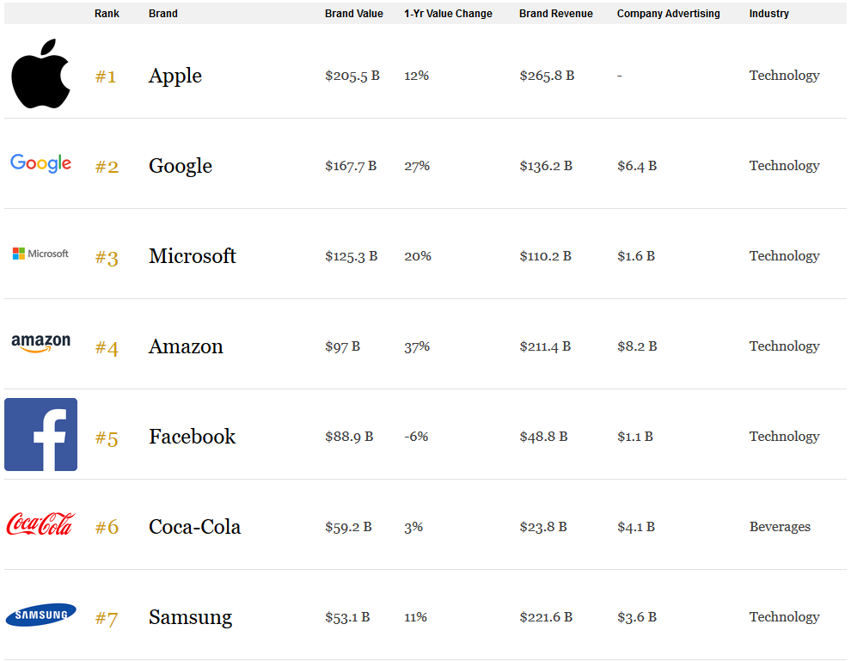
Entrants: Brand Name / Influence
Conclusion
Well-established brand name required for entry
Higher barrier for entry

